Slide 1
UCPLA DREAM TEAM ABSTRACT CONCEPTS
Hackaday Prize 2020

Slide 2
OUTLINE
Introduction
Design Goals
The Platform
Path 1: Adaptive Smart Remote
Path 2: Low-cost Joysticks
Path 3: Connected Platform App
Questions, Comments and Feedback Time

Slide 3
INTRODUCTION
Our Big Mission
Develop an affordable open-source platform to democratize assistive technology for interacting with the digital world.
Our Potential Users
Movement disabilities range from full on quadriplegic to difficulty grasping objects.
Target Devices
Connected and controllable device range from a simple TV to Race Cars.

Slide 4
DESIGN GOALS
Universal Control - Interface with all connected devices in some way
Accessible - Easily usable by anyone, especially users with disabilities
Portable - Long battery life and/or easily charged
Expandable - Integrate with many input methods
Customizable - Functions and actions are easily customizable
Low-cost - Maximize affordability to allow for greater distribution
Durable - Able to last with extensive even forceful use

Slide 5
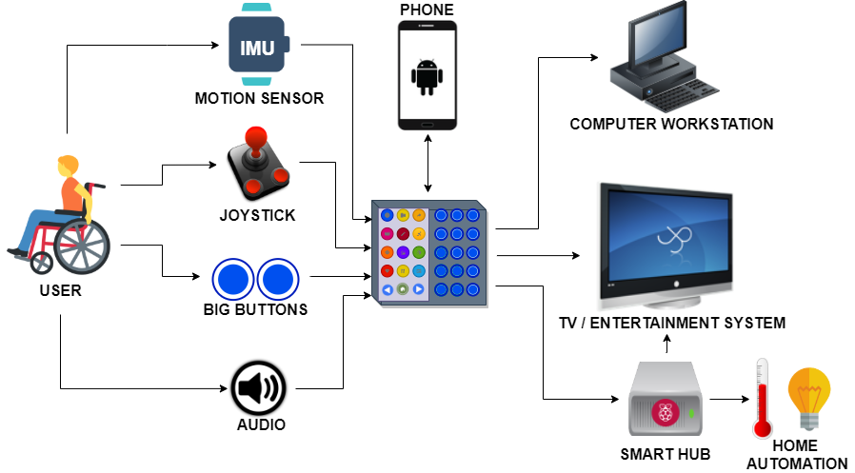
OPEN-SOURCE PLATFORM CONCEPT
PHYSICAL WORLD
DIGITAL WORLD

Slide 6
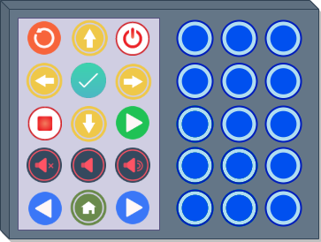
PROPOSAL 1 ADAPTIVE SMART REMOTE

Slide 7
Target Users
Cannot use existing devices without lots of effort
Have a line of sight with device
Able to use their hands and/or feet to interact with the device
Want to operate and access this device independently

Slide 8
Concept Goals
A versatile low power device usable out of the box, no additional devices or supporting platforms required
Easiest and intuitive for users with limited mobility
Unlimited functions by using a display to show users what functions are currently assigned to each button and can be changed by the user
Integratable with existing connected devices and systems
Easily expandable with other physical input methods to allow it to be adapted to specific user needs
A speaker could be added for additional feedback and options
Users could use the remote as an assistive communications device (This may require quite an extensive amount of time to initially develop)

Slide 9
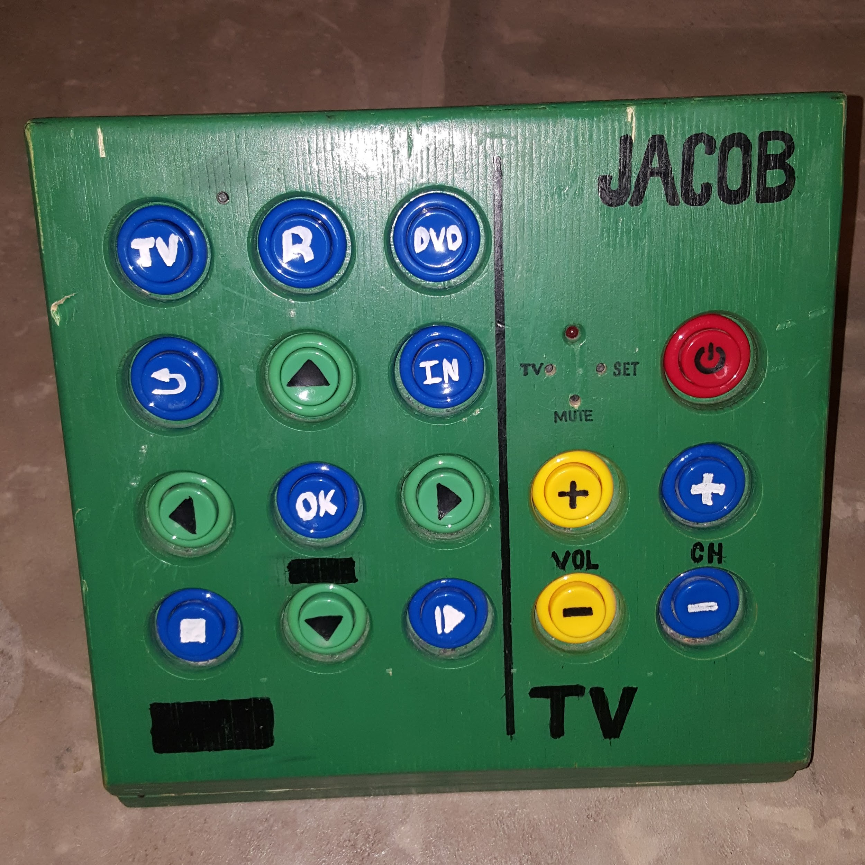
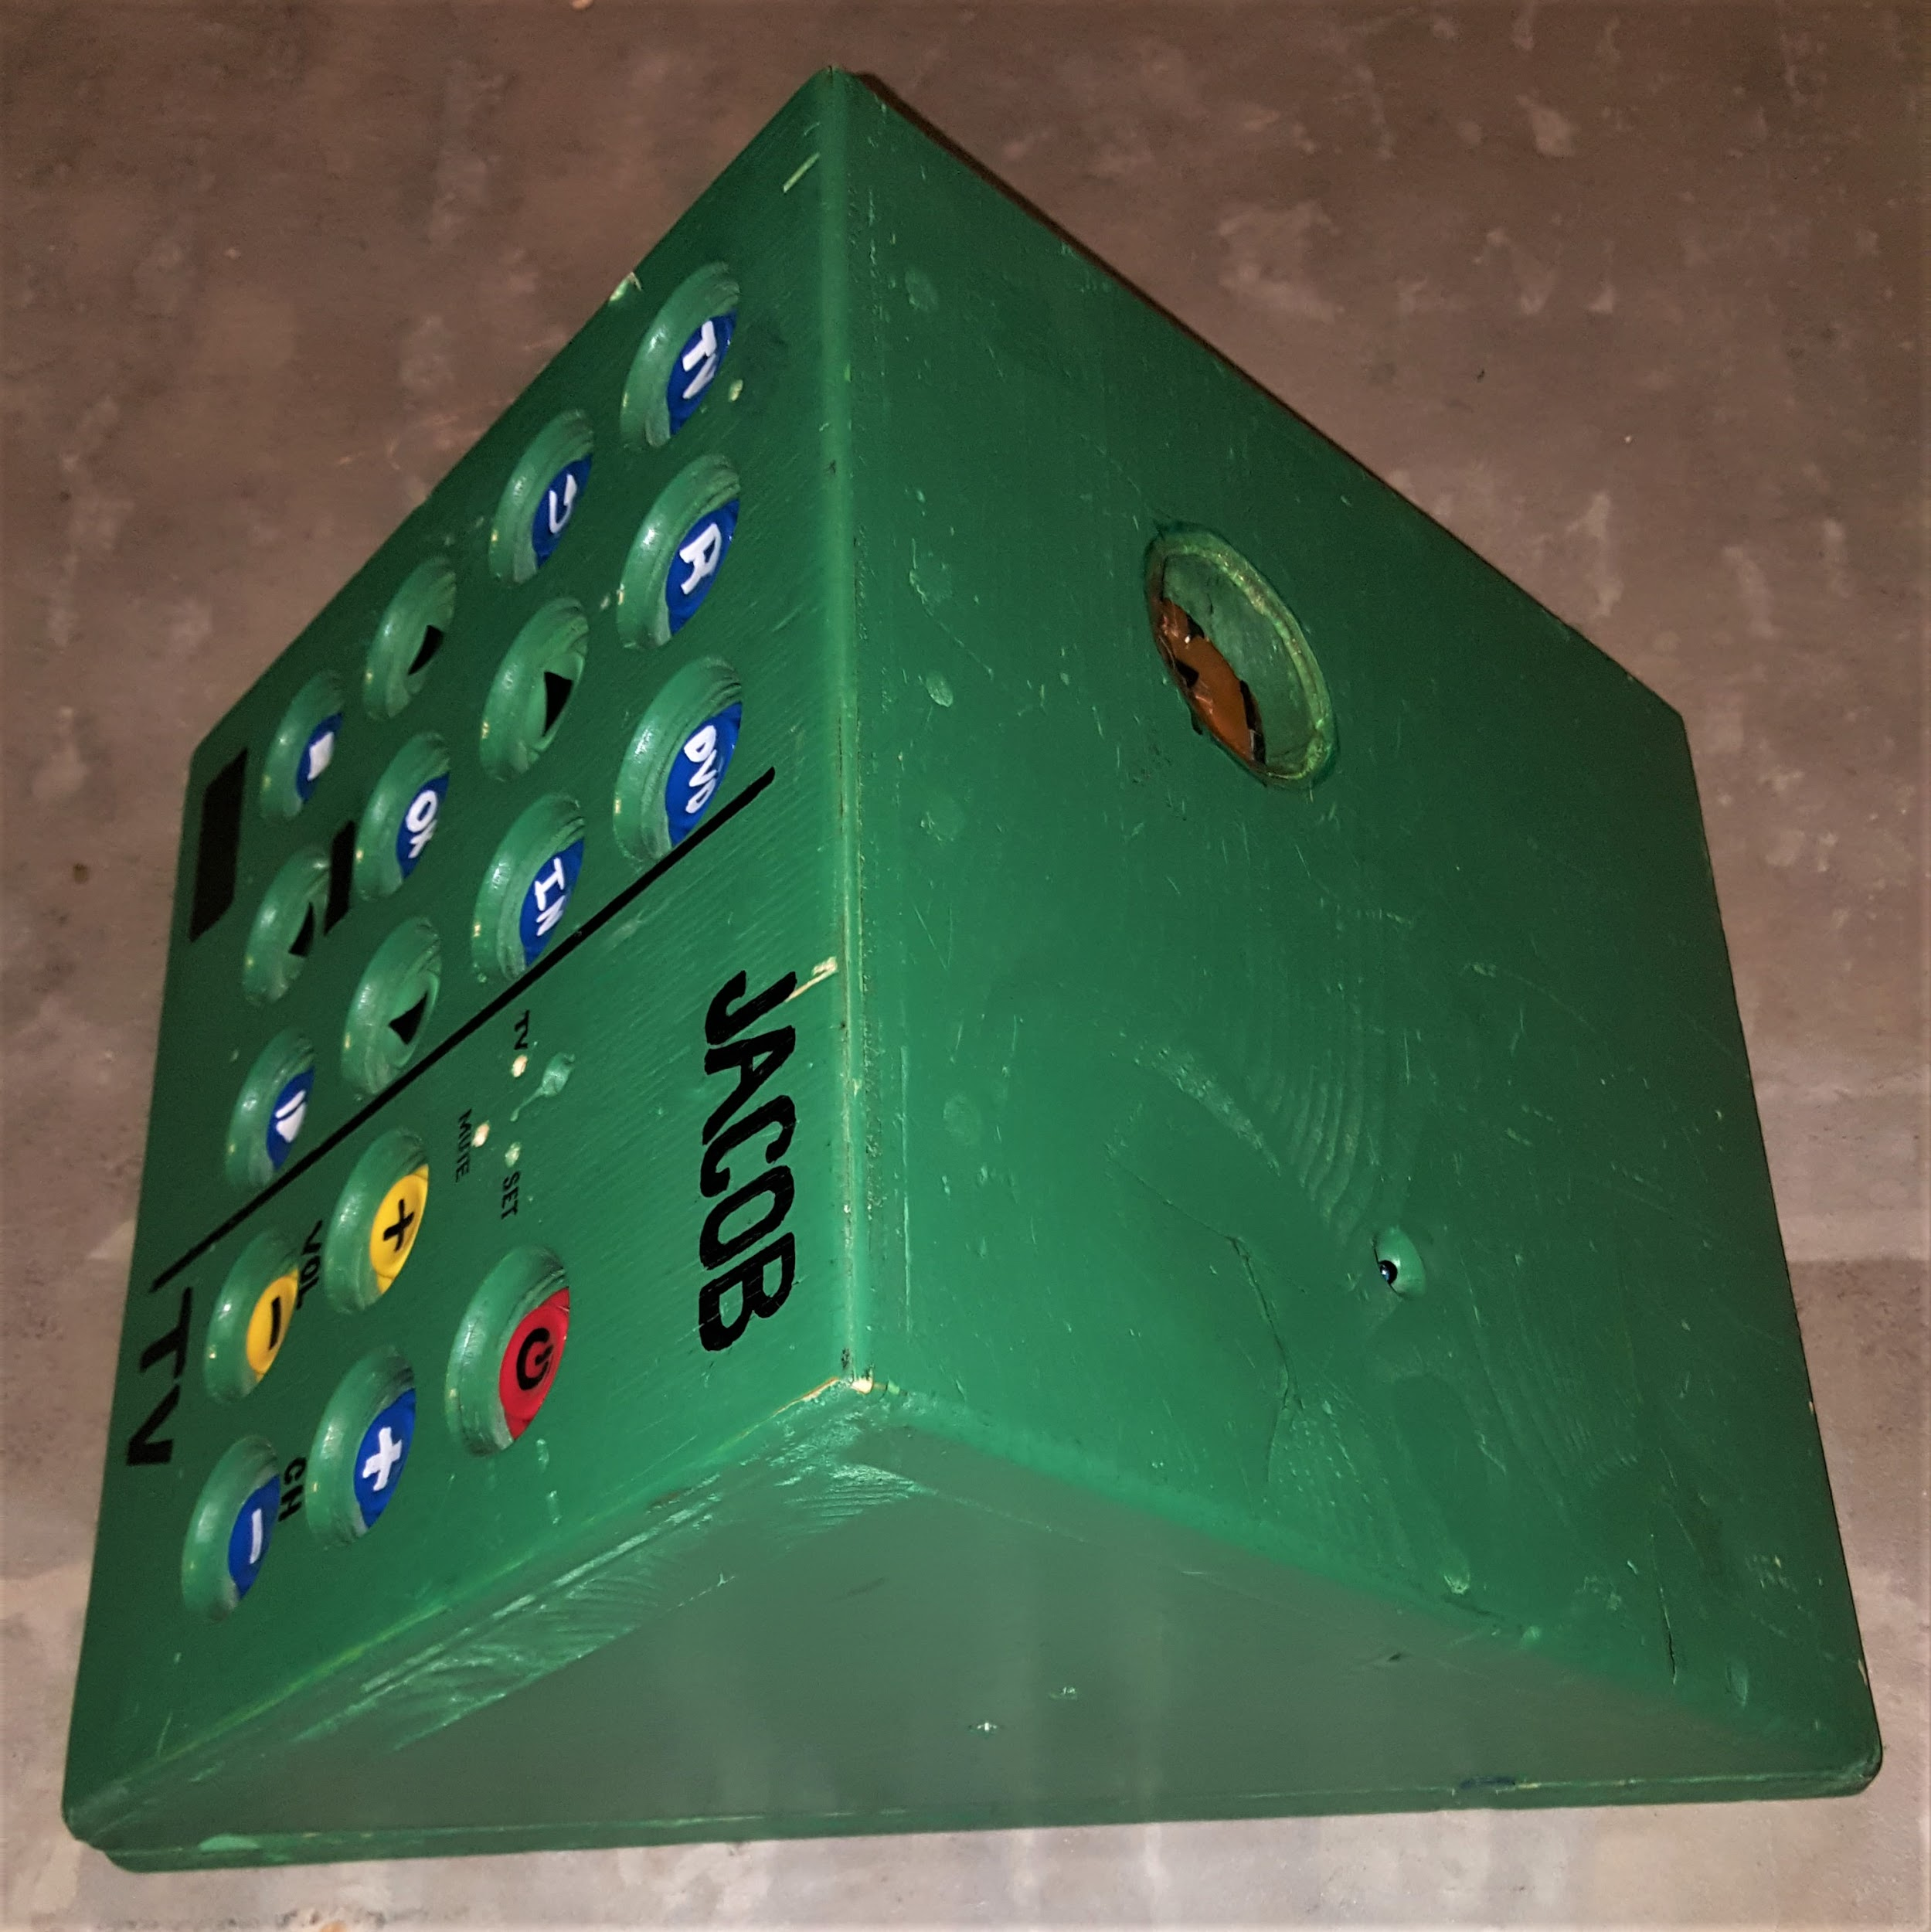
Feedback from existing users
We love that J has his own accessible remote control. It is so nice that J is able to access the TV
independently! He has freedom to choose his programming, and it saves me a lot of time--time I would
otherwise need to take to physically change any channels for him AND, especially, time trying to figure
out/guess what he wants to watch! What a blessing! Deb C, West Jordan, UT
A less advanced version of this concept has been tried and tested for years. Time to bring it to the next level.

Slide 10
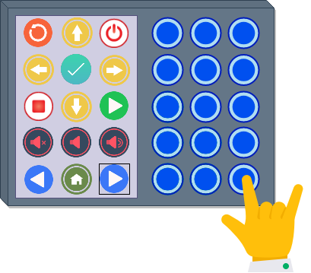
TURNING THE PAGE
A low power displays shows what each button will currently do. In this example pushing the next page button
shows another page of functions for each button.
THE POSSIBILITIES ARE ENDLESS

Slide 11
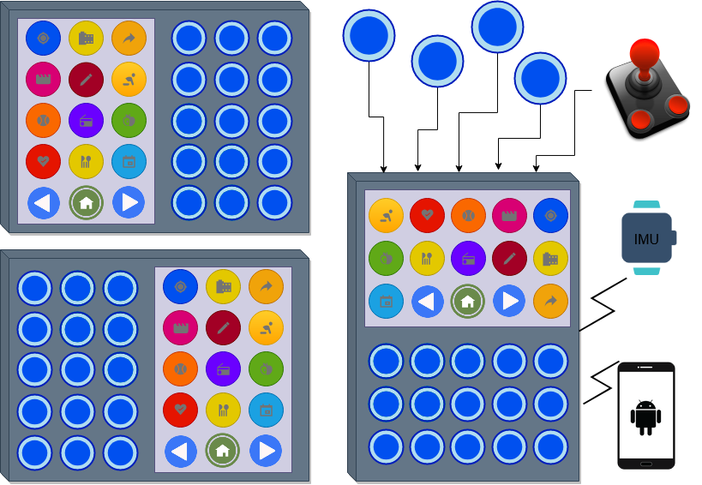
CUSTOMIZABLE AND EXPANDABLE

Slide 12
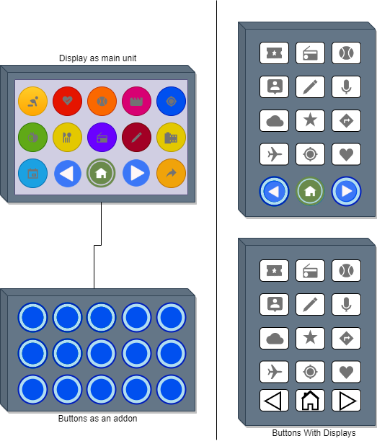
VARIATION 1
VARIATION 2
The buttons could have integrated displays
Smaller unit
Still could add other input methods
Display is main unit
Attach buttons, joystick or other input methods.

Slide 13
PROPOSAL 2: JOYSTICKS FOR COMPUTER WORKSTATIONS

Slide 14
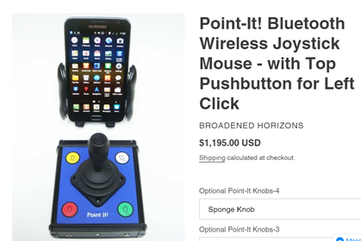
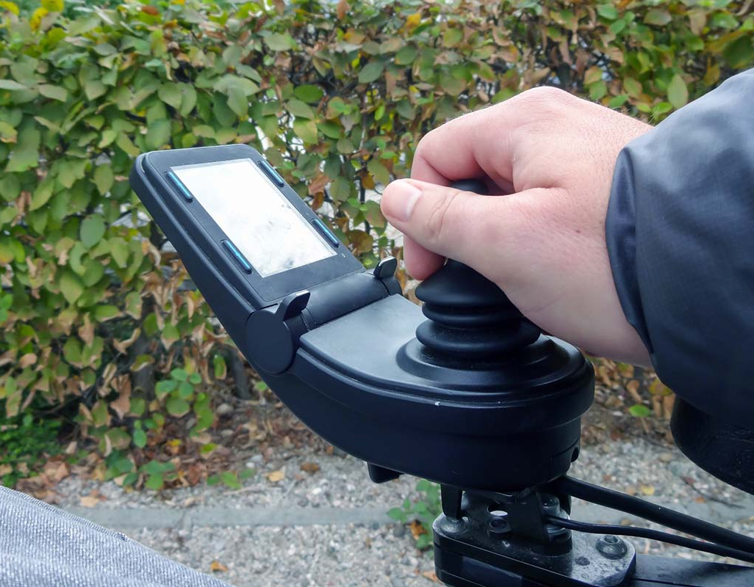
Existing Joysticks
Positives
Negatives
Expensive
Limited options
Familiarity
Compact design
$1195!!!
http://marcsmobility.com/
https://inclusivetechnologies.org/

Slide 15
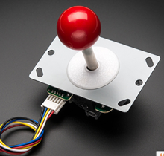
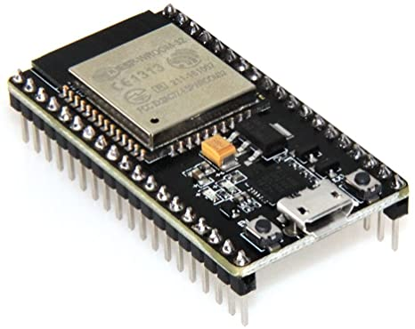
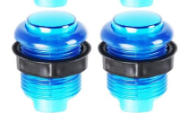
APPROACH 1: DEVELOP LOW-COST JOYSTICK PROCESS
STEP 1: Identify off-the-shelf electronics
Find the simplest, cheapest process to make a bluetooth joystick
Target cost < $50

Slide 16
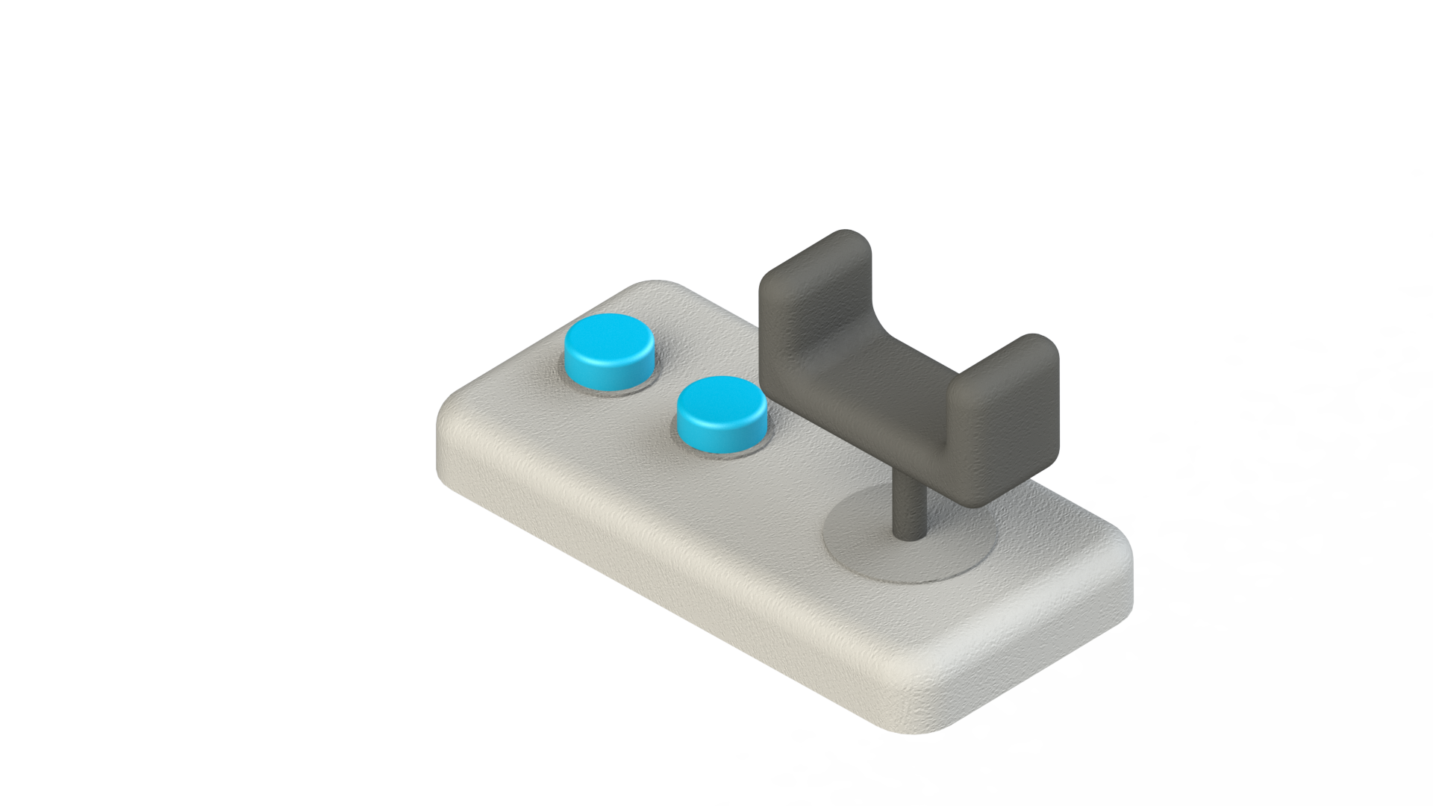
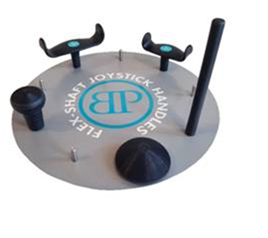
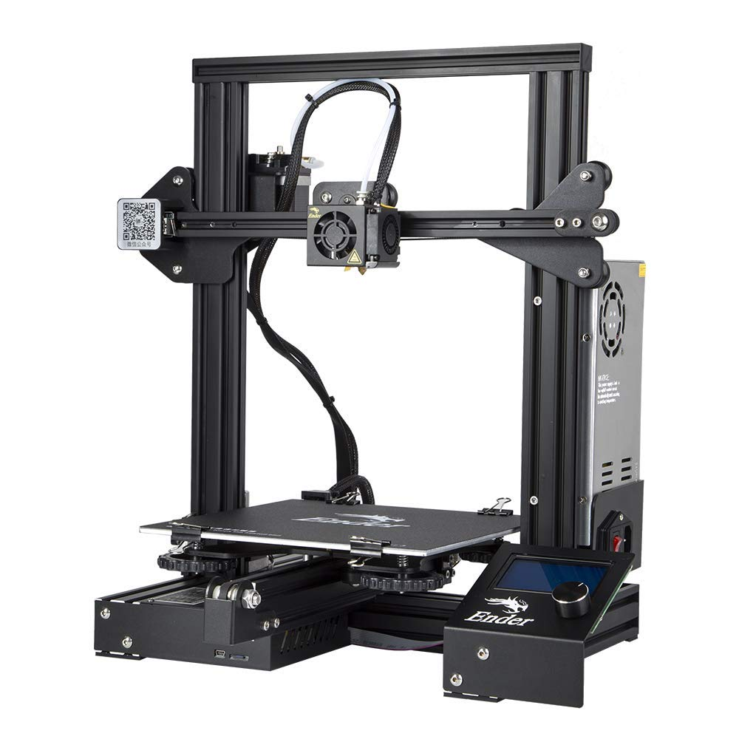
APPROACH 1: DEVELOP LOW-COST JOYSTICK PROCESS
STEP 2: Create a digital library of parts
Joystick handles
Joystick base
STEP 3: Build custom joystick
Get user input (best handle, button placement, button sizes…)
Add personal touches

Slide 17
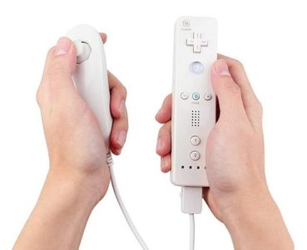
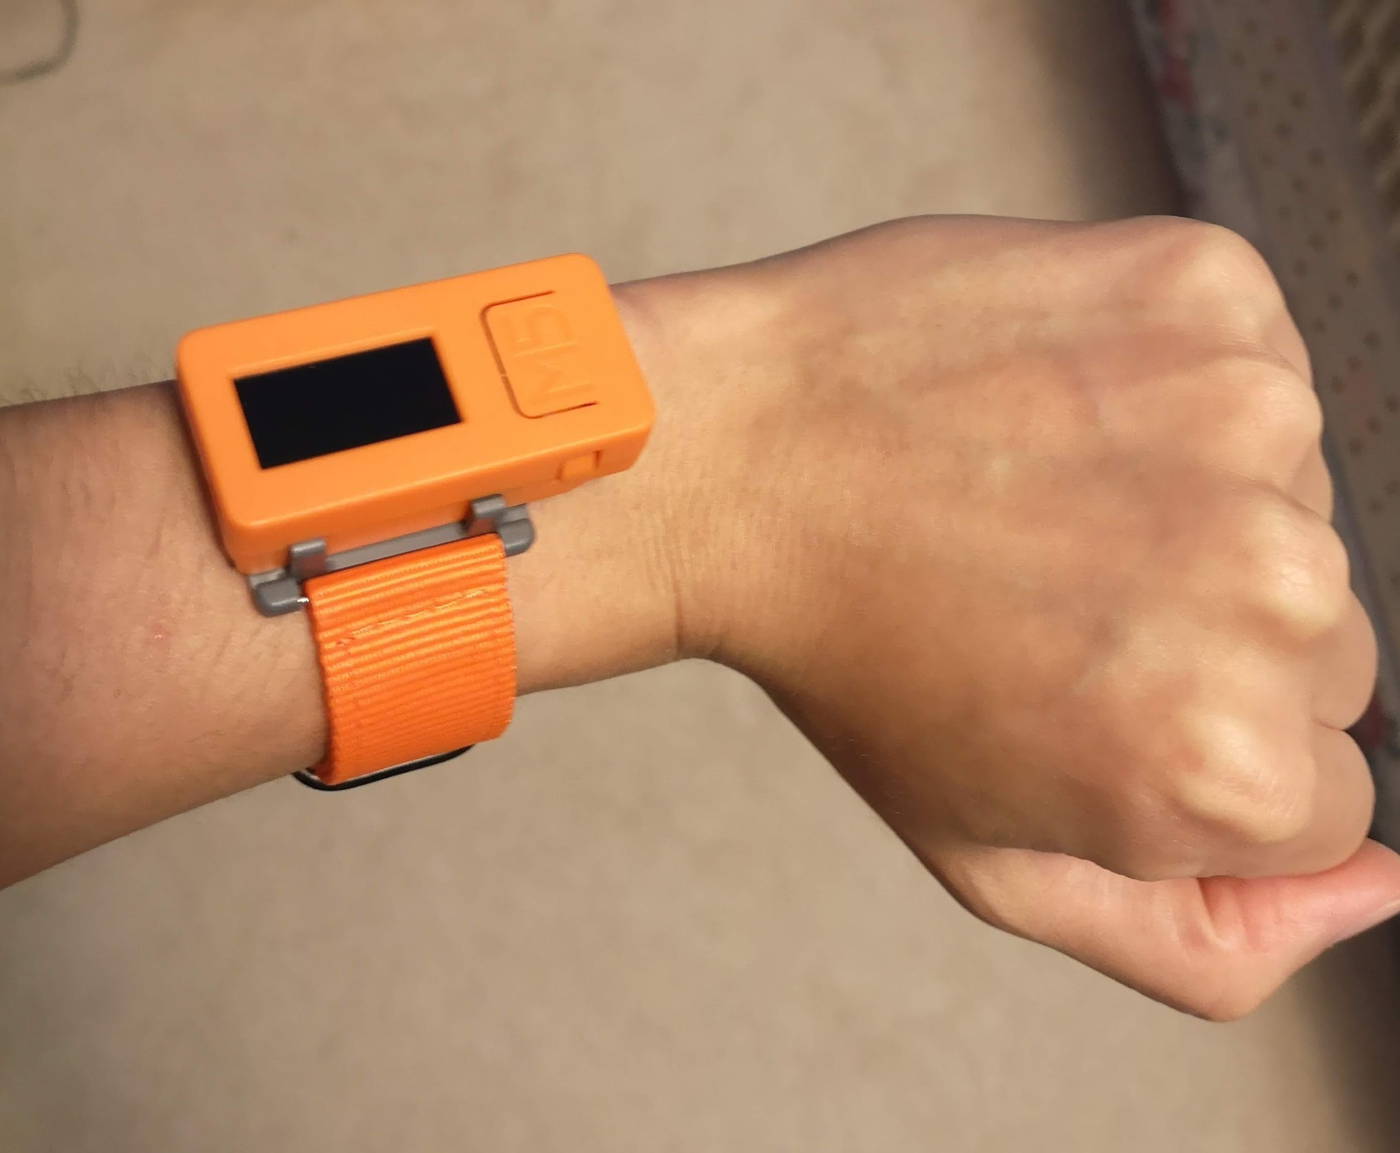
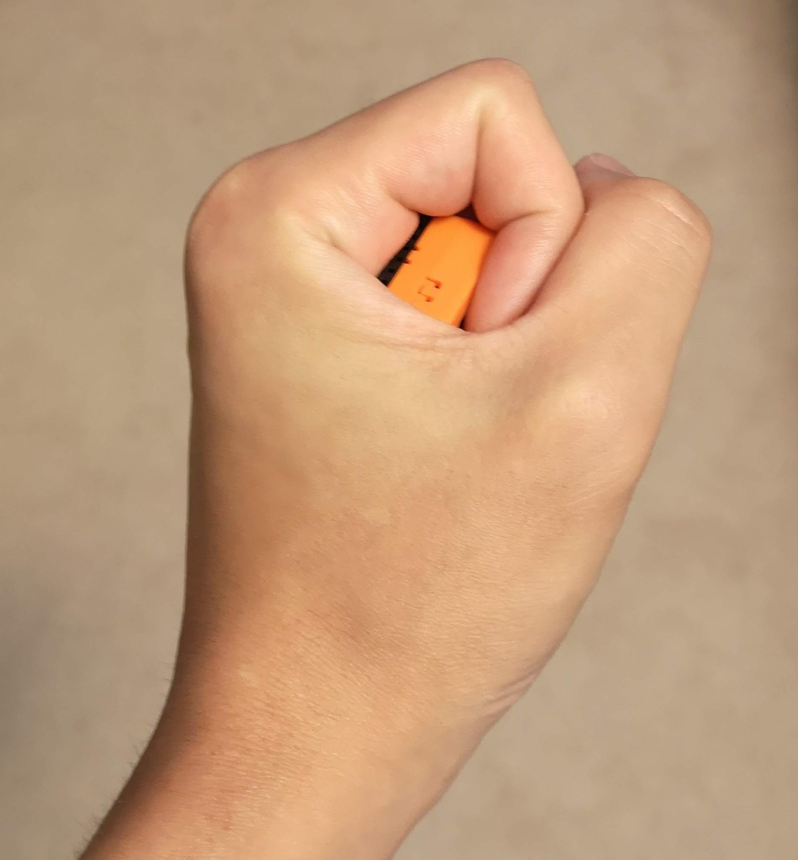
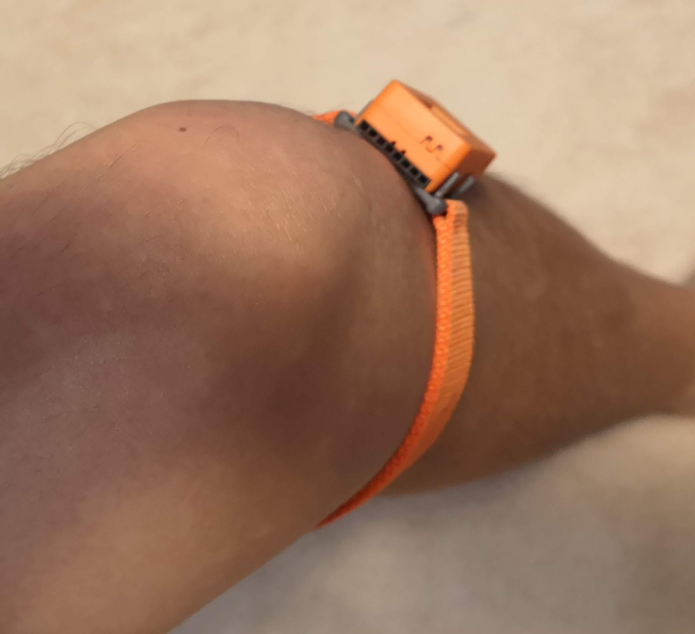
APPROACH 2: MOTION SENSING JOYSTICK
Input based on position of body
Within natural motion - extension of body
Wearable device
HAND
WRIST
KNEE

Slide 18
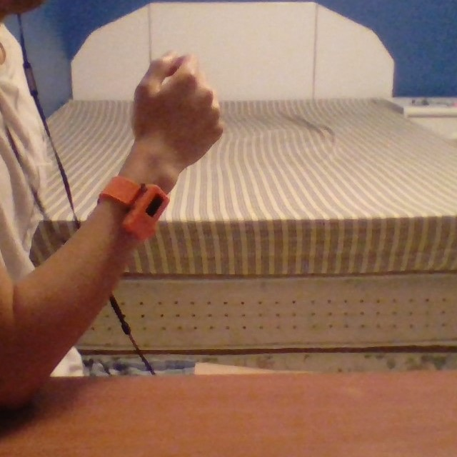
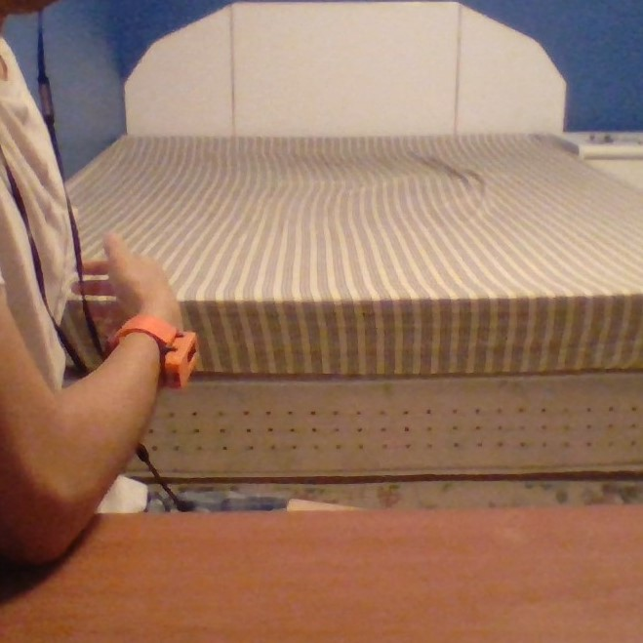
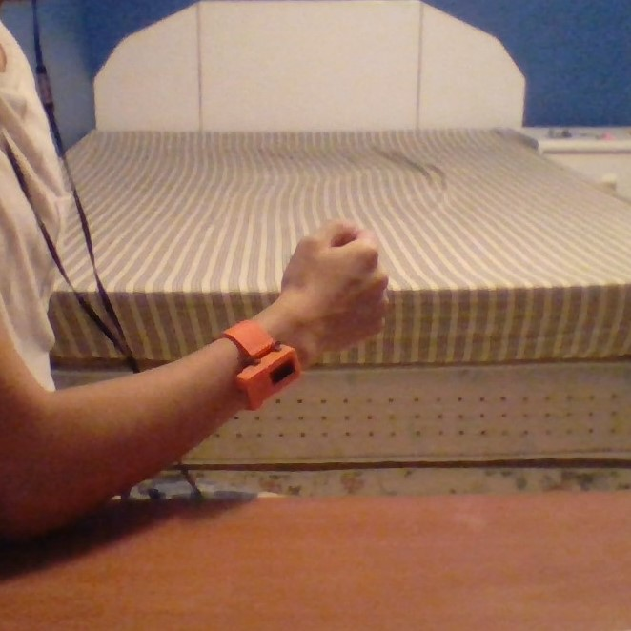
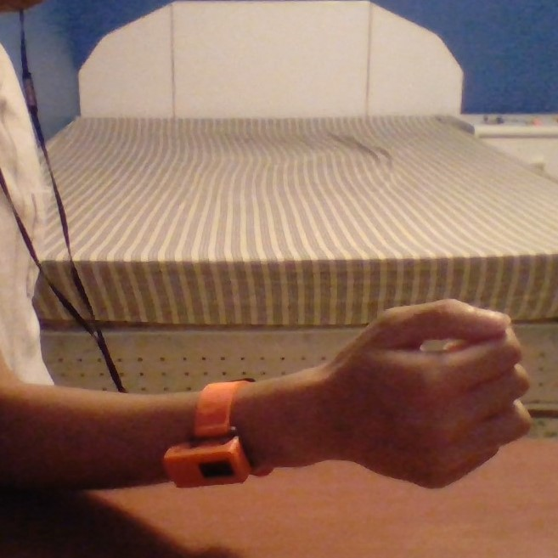
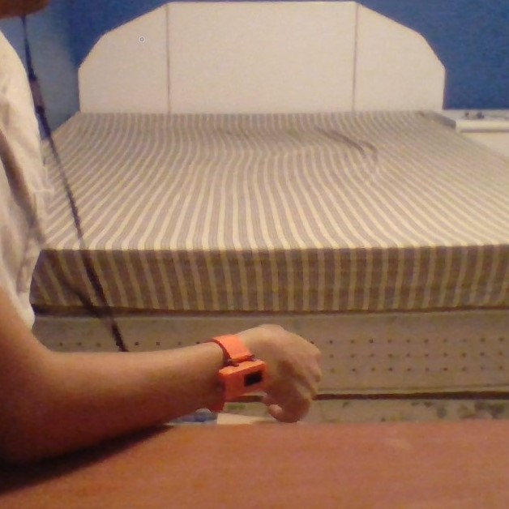
EXAMPLE: USING ELBOW
AS PIVOT
FORWARD
LEFT
NEUTRAL
RIGHT
BACKWARD

Slide 19
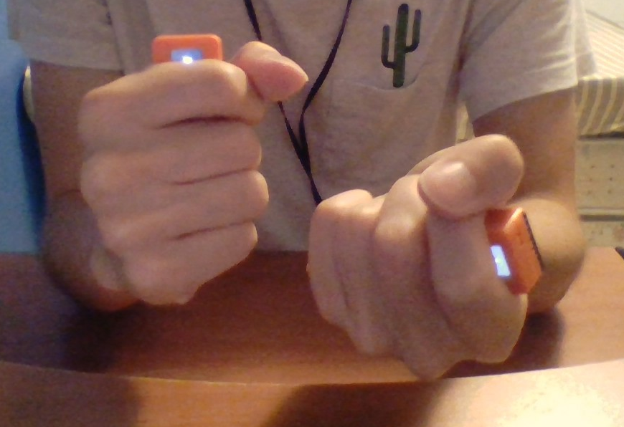
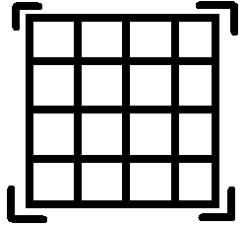
Test Videos (Links in abstract)
Images drawn in Paint using only these joysticks
2 joysticks used to control mouse/keyboard controls

Slide 20
PROPOSAL 3: PLATFORM APP

Slide 21
Why Software?
The cheapest solution for the production once developed :-)
The easiest to distribute (no shipping costs, no 3D printing errors, no electronic components backordered, out of stock)
The easiest to adapt and to test with the existing devices our users own
The availability of these devices is possibly the highest as they are ubiquitous * - among existing reports, 3 personal interviews, Google Forms responses we collected + feedback from UCPLA team + general trends in personal mobile devices - assessment is that 100% have a phone, tablet, phone or smart assistant off the shelf (commercially available)** = no potential cost to the end user
*http://www.wirelessrerc.org/sites/default/files/publications/sunspot_2019-01_final_use_of_mobile_phones_by_individuals_with_disabilities_2017-2018.pdf
** is not equal to actively using it

Slide 22
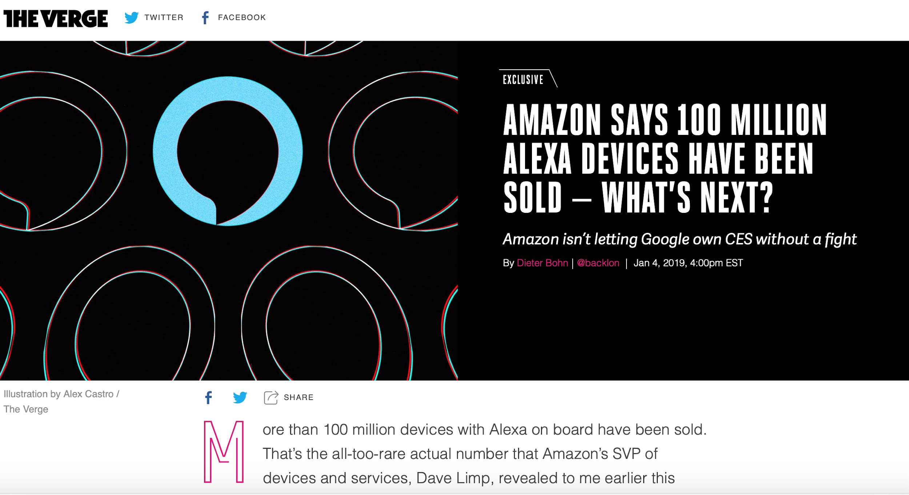
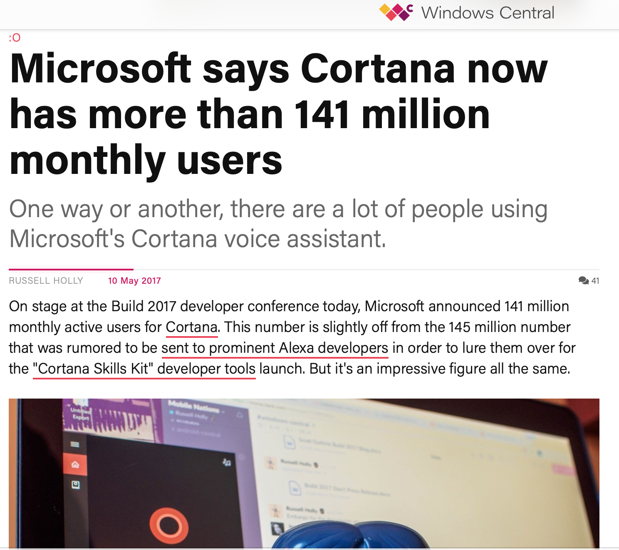
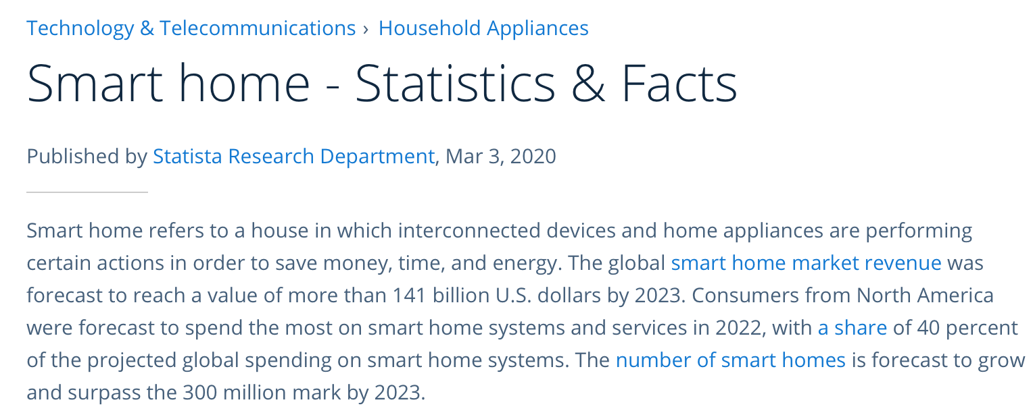
Ubiquity

Slide 23
Quotes from the users and UCPLA team
“Individual utilizes all of the above: smart phone, tablet, etc as they are also consumers of the times. But what is really lacking Is the HOW / HOW TOs can they utilize these items to fit their unique physicality. (There are no other examples of these either through apps or videos)”
UCPLA Team Member1, July 13, 2020
“I like to watch Youtube, and I like to learn more about what is being developed, that can help me and people like me to be more independent at home, when using home appliances, for example. There are a lot of resources but they are not easy to find for people like myself”
Responder 3, July 16, 2020
Quotes are presented as they were provided.

Slide 24
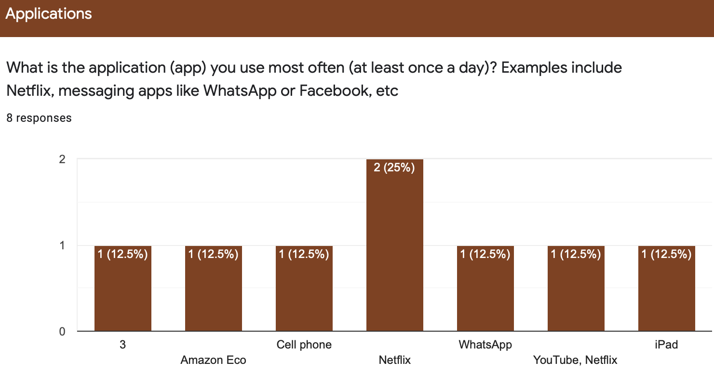
The responses can be precise or….not
Preliminary responses generated from our Survey, distributed July 14, 2020. Not yet open for interpretation as enrollment is open. Used here for illustrative purposes only

Slide 25
Survey results used to generate ACTUAL suggestions
Example of response from the Platform App:
“For Tommy, the best option will be to set up the open source smart home system from OpenHAB, as the smart appliances control is requested by Tommy very often (10+ times).
The preferred communication method for Tommy is voice; the second preferred is touch. Tommy can either check for:
this offer from Amazon Echo (cost - $39, tutorials excluded/N/A; integration with open source smart home system excluded);
this Hackaday project from 2020 by Dream Team UCPLA (cost - $50, tutorials for 3 smart home systems included; 10 tutorials of use in total)”
This option might also enable automation of some of the assessment tools used by UCPLA team

Slide 26
Main Features and Pros
Ultimate Versatility and Personalization
Based exclusively on the desires and capabilities of the current user - universal and unique for this specific user
Based on the existing open source or commercial products the user owns, wants to own
Checking for the tutorials and videos to help the user in THEIR condition, not just “Start using iPad” Tutorial
Learning curve short to non-existent
Very incremental: potential of easy integration with the suggestions from Sara, Alex, Ruben, Kelvin as well as 1000 more hackers, researchers, designers

Slide 27
In a nutshell: No Limitations*
Any device: joystick; tablet, wheelchair, handband
Any modality: voice, touch
Any budget ($0 to infinite)
Any system (even the ones already purchased by the users)
Any disability
Perfect scenario

Slide 28
Cons and Challenges
Database to be built and constantly updated
Might require full or part time person at the centre
Might require additional generation of content and its adaptation (specifically for the users not being able to use/have tablet, smartphone)
Privacy concerns to address

Slide 29
Big (and honest) vision
Best-case scenario:
Creating the unified platform over multiple US states to include multiple centers
Expanding into the world-wide use
Creating the unified database with great stats available
Medium-success case scenario:
Creating a local network of resources for the existing community, county
Centers-wide initiative only
Stats for the state-wide use
Worst-case scenario:
User will be able to find easily more supporting and fitting tools for them
Can communicate easier by sharing the results of the survey with the centers

Slide 31
Thank you for your attention!
Questions, Comments and Feedback

